Slide 1
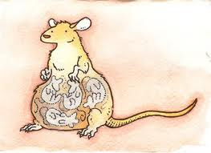
Rats
Emma Bartley

Slide 2
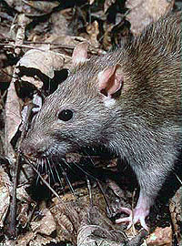
Taxonomy
Kingdom: Animalia
Phylum: Chordata
Class: Mammalia
Order: Rodentia
Superfamily: Muroidea
Family: Muridae
Subfamily: Murinae
Genus: Rattus
64 different species

Slide 3
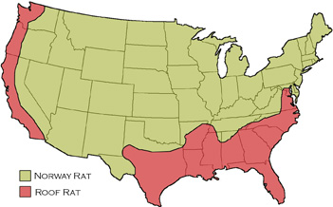
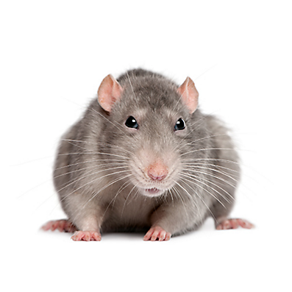
Geographic Location
Rats can live anywhere food and shelter is available(widespread across the globe).
They will make shelter on or below ground level.

Slide 4
Food Capture/ Diet
Feed on nutritionally balanced diets, also stale or contaminated food.
Omnivores, prefer cereal grain, meat and fish, nuts, and some fruits.
Need ½ to 1 ounce of liquid a day when feeding on dry foods. If they feed on moist foods the liquid intake will decrease.
Before birth fetal rats detect odor-bearing particles that come from the mothers diet and pass the placental barrier.
During nursing the rats receive information from the mothers milk. They prefer foods that she eats during this time.
When young rats are weaning they follow the older rats, and use they also find the places where the adults have previously left their scent.
Finding food is based on social interactions(eat foods other rats have eaten)
Use their sense of smell to detect what kind of food they want to eat and where that food is.

Slide 5
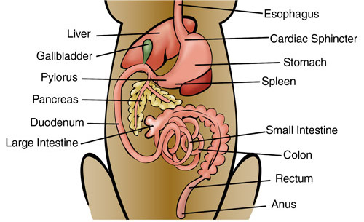
Digestion
Shares digestive and respiratory system.
Epiglottis separates the two systems.
Digestive system is made up of the mouth,
pharynx, esophagus, stomach, small intestine,
large intestine, rectum and anus.
Digestive system takes in food and processes it
Doesn’t break down food with saliva, but with contractions of the stomach.
Food goes into the small intestine after stomach to get the nutrients from what has been ingested.
Rest of the food moves into the large intestine(colon), water is removed and prepares to leave the body.
Feces go through the rectum and out the anus.

Slide 6
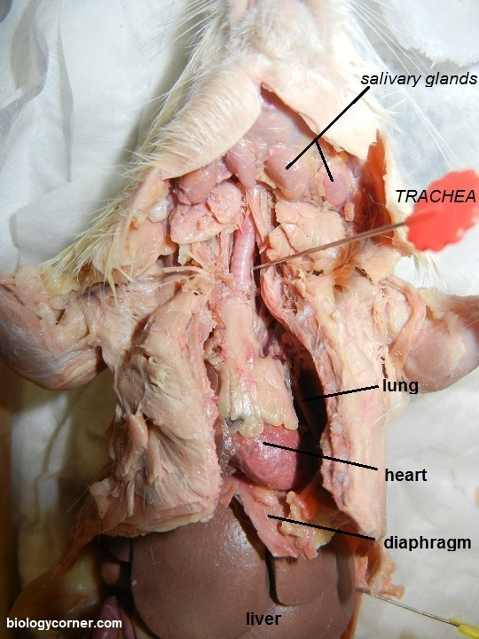
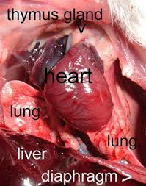
Gas Exchange
Take in oxygen and
release carbon dioxide.
Take in oxygen through
mouth or nose.
Has 2 lungs.
In the picture it only shows
one, but on the other side
there is another lung.

Slide 7
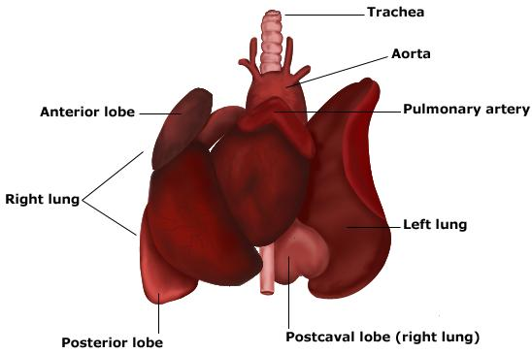
Circulation
Major organ involved is the heart, also involves blood vessels and blood.
Closed circulatory system( pumps blood through vessels)
Circulatory system is used to transport nutrients, oxygen and hormones throughout the body.
Blood goes to the lungs for oxygen,
then to the heart, then throughout the body.
The system moves oxygen and blood
throughout the body and removes waste
and carbon dioxide from the blood.

Slide 8
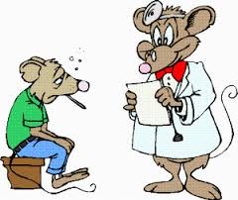
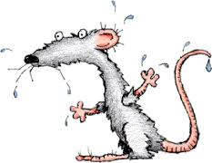
Immune System
Stress can cause more vulnerable to illness.
They cannot vomit or burp, esophageal muscle is to weak to open the barrier to vomit.

Slide 9
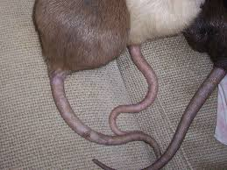
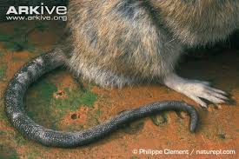
Homeostasis
Hair to keep them warm.
Tail shrinks and expands based on body temp. Since they do this, they do not sweat.

Slide 10
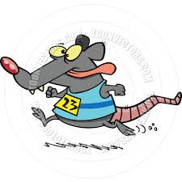
Thermoregulation
Controlled by the nervous and endocrine system.
Vessels in the tail expand to burn up the heat and shrink to save heat.
Control the body temperature
with their tails.
Don’t sweat or pant to cool down.
If become too hot, they can
experience heat
strokes.

Slide 11
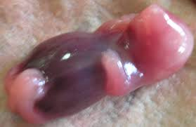
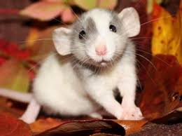
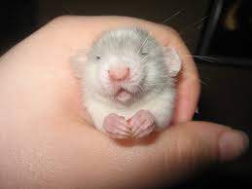
Reproduction
Sexually mature at 5 weeks.
Rats don’t recognize incest.
Breed year round(females every 4-5 days).
Females become infertile at age 2.
Menopause starts around 18 months.
Mate within 10 days( two heat cycles).
Male can make female pregnant even if she is not in heat.
Time of pregnancy is usually 21-23 days.
After birth the female will be in heat 24 hours after.
When pregnant, female becomes more aggressive.
Birth process:
Time duration: 1-2 hours
Female helps deliver the babies with hands and teeth.
If mother experiences a difficult birth she may kill and partially eat the healthy babies.

Slide 12
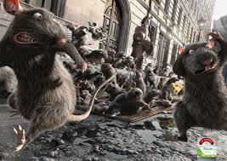
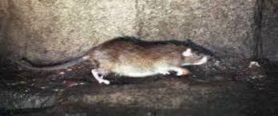
Movement
Tail helps to balance when walking on small surfaces.
Can stand up on back legs when looking at new areas and smelling air currents.
Have bad eyesight, use whiskers to move around.

Slide 13
https://www.youtube.com/watch?v=VSxhN6qhAXU

Slide 14
Dissection
https://www.youtube.com/watch?v=RaTzR3II10Q
https://www.youtube.com/watch?v=l4kaGOVYlOI

Slide 15
Quiz
https://docs.google.com/a/student.harrisburg.k12.or.us/forms/d/10AqE1jEyAO-3pHo022jFOjkS_00oA4jYW-bVjA45_c0/edit

Slide 16
References
http://icwdm.org/handbook/rodents/NorwayRats.asp
http://www.ratbehavior.org/FoodChoices.htm
http://umanitoba.ca/Biology/BIOL1030/Lab4/biolab4_4.html
http://biology.kenyon.edu/courses/biol10/110pdfs/10Digestive.pdf
http://nyadissectiongroup4.wikispaces.com/The+Digestive+System+of+a+Rat
http://umanitoba.ca/Biology/BIOL1030/Lab4/biolab4_7.html
http://www.havahart.com/rat-facts#geography

Slide 17
Dissection Write Up
https://docs.google.com/a/student.harrisburg.k12.or.us/document/d/12envmYGesx2JhJG0Ond4Xa9nCaQAHjBkEk1j0G2fgw8/edit

