Slide 1
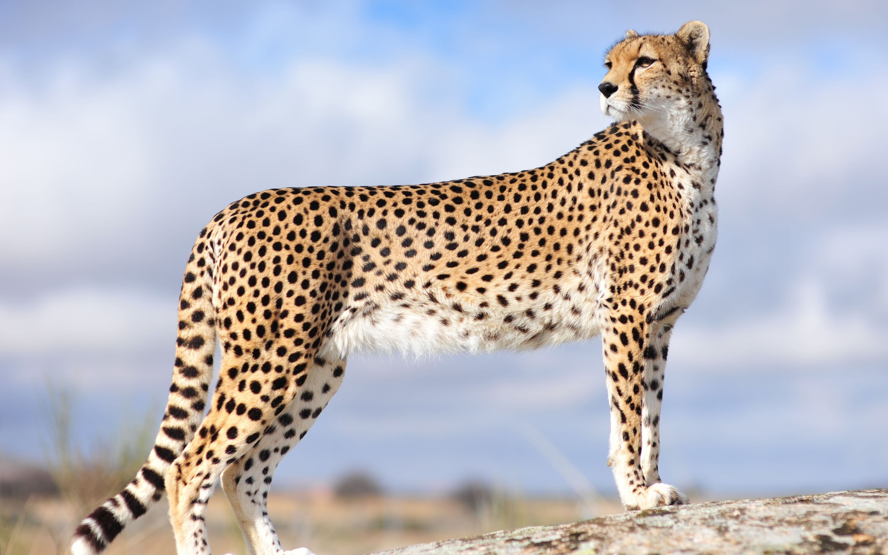
Acinonyx jubatus
(Cheetah)

Slide 2
Taxonomy
Kingdom: Animalia
Phylum: Chordata
Class: Mammalia
Order: Carnivora
Family: Felidae
Genus: Acinonyx
Species: Acinonyx Jubatus
Common Name
Leopard, Lion, Tiger, Jaguar, Snow Leopard

Slide 3
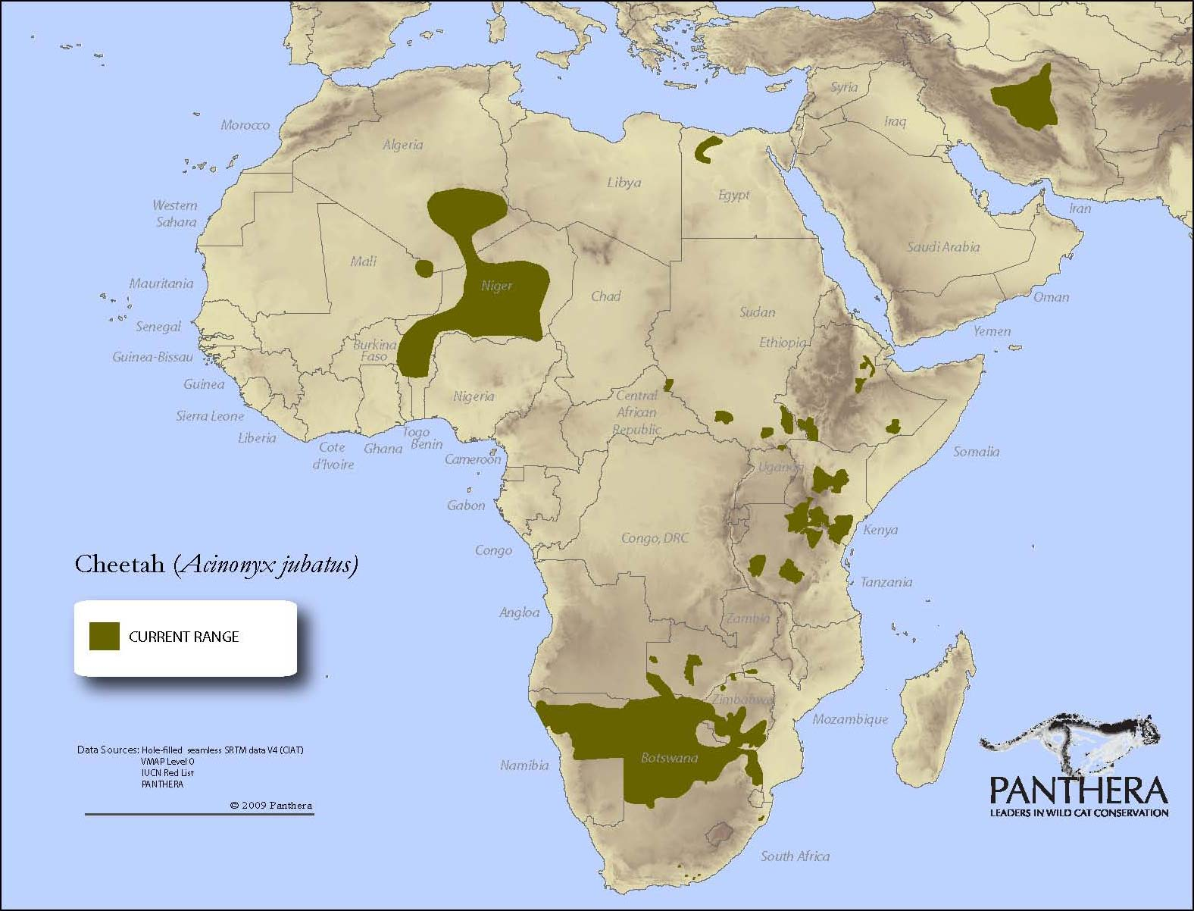
Geographic Location

Slide 4
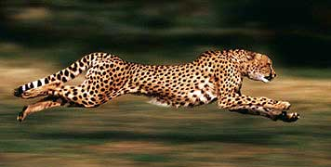
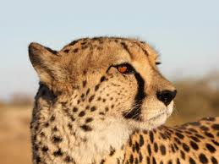
Basic Form and Function
Specialized muscles allow them to achieve a greater stride for faster acceleration.
Spots used for camouflage and helps hunt their prey
Feet that have hard and less rounded pads that allow them to have more traction and make sharp turns.
Semi-retractable claws to grab the ground for traction.
Flexible spine that makes their long stride and speed possible.
Tail for balance.
Tear marks to help reflect the sun.

Slide 5
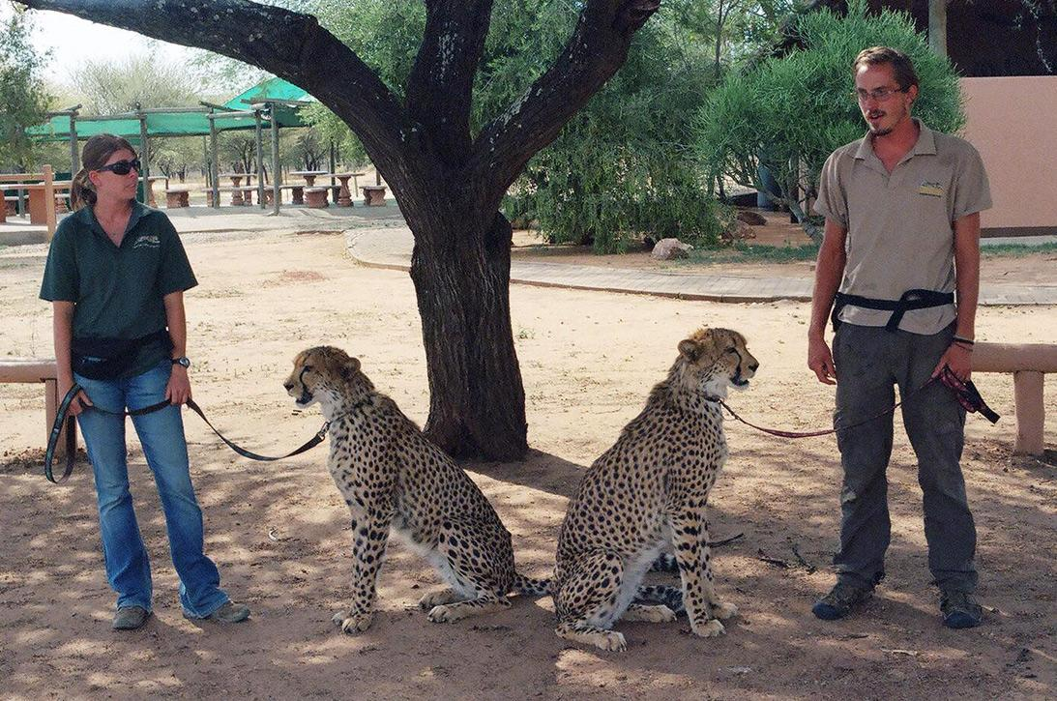
Size and Speed
Speed:
Accelerates from 0-64 mph in three seconds.
Top speed is around 70 mph.
During hunting and running they hit about 93 km/h.
In short bursts and running they hit about 112-120 km/h.
Size:
Can be from 83 to 145 lbs.
70” to 86”

Slide 6
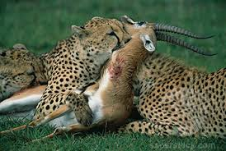
Food
They are carnivorous animals. When preying on animals they will stalk the animal first, then attack and kill the animal. They prey on animals such as gazelles, wildebeest calves, impalas, and other animals that have small hoofs that are in the habitat. They also prey on rabbits, birds, hares, antelopes and warthogs. The food that they kill must be eaten quickly or hidden from other animals that might steal it. Cheetahs can also live off of a drink of water for three to four days.

Slide 7
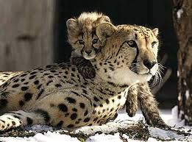
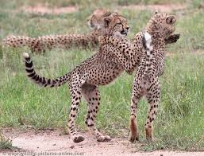
Behavior
Hunt prey during daytime due to poor night vision.
Solitary animals, while females raise the cubs in solitude.
Most sociable cat because siblings will stay together for six months after leaving the mother.
The male cheetahs usually will live in small group of brothers for life.
When mating the men become aggressive towards each other.
They will give up their food to another animal to avoid a fight.

Slide 8
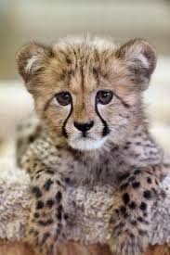
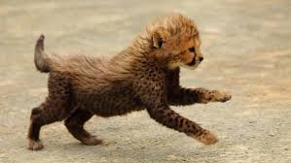
Reproduction
Males ready to mate at the age of one.
Females ready to mate at the age of two.
Cheetahs will mate with more than one.
No mating season, mate year round.
Males will not stay with female after mating.
Pregnancy will last for about three months.
The litter will be no bigger than 8 cubs.

Slide 9
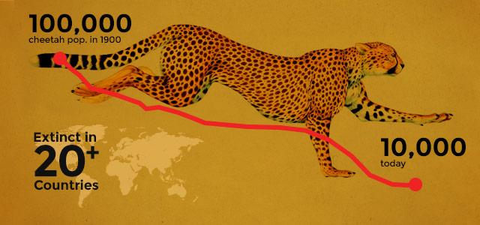
Outlook
Cheetahs are having a hard time surviving with the taking over of their habitat, loss of prey, and the human-wildlife conflict. Humans have owned cheetahs before.

Slide 10
Videos
https://www.youtube.com/watch?v=U6K-F9Bjl8s
https://www.youtube.com/watch?v=lGhTCPzMHvY

Slide 11
References
http://www.speedofanimals.com/animals/cheetah?g=t
http://ielc.libguides.com/content.php?pid=658823&sid=5456881
http://cheetah.org/about-the-cheetah/
http://bigcatrescue.org/cheetah-facts/
http://www.conservationinstitute.org/cheetah-facts/

